Slide 1

BannerWeb
UX Case Study
Vandana Anand, Kaidi Ding, Liangyu Liu, Jiadong Sun, Joseph Yuen
Notes:
Hi everyone, we will be presenting our User Experience Case Study on BannerWeb to you WPI, our stakeholder.

Slide 2
Goal
Present a holistic view of BannerWeb’s design and potential implementation
Notes:
Vandana
The goal of our project is to present a holistic view and design of BannerWeb as well as it’s potential implementation

Slide 3
Background
Notes:
Vandana

Slide 4
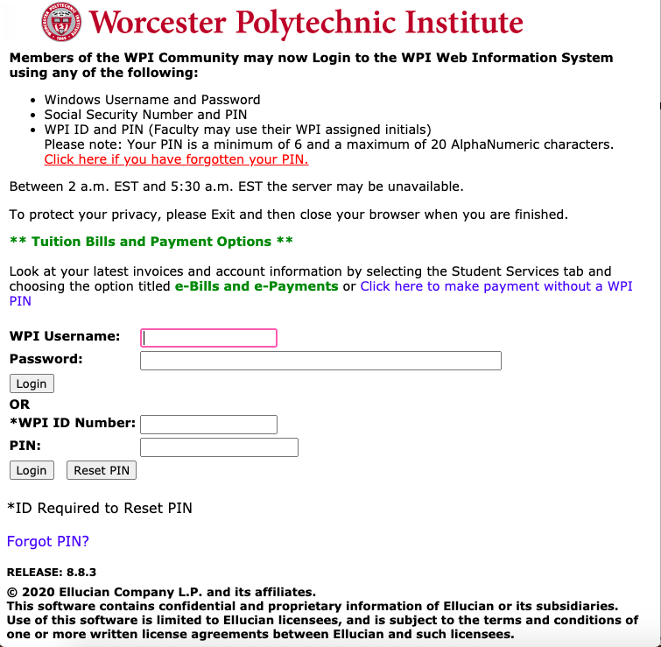
Background
BannerWeb
What is it?
WPI website that organizes and processes required logistical admin-related activities for its users
Users
Students and WPI Employees
Notes:
Vandana
BannerWeb, depicted on the right, is a WPI website that handles logistics and admin activities for students and WPI employees.

Slide 5
Problem
Notes:
Joe

Slide 6

Problem
Why this research matters?
Most WPI students have a negative user experience with BannerWeb
Potential loss of opportunities
Students want BannerWeb to be improved
Opportunity for overall gain
Notes:
Joe
We first want to talk about why this research matters. The first reason is because many WPI students have a negative user experience with the program

Slide 7
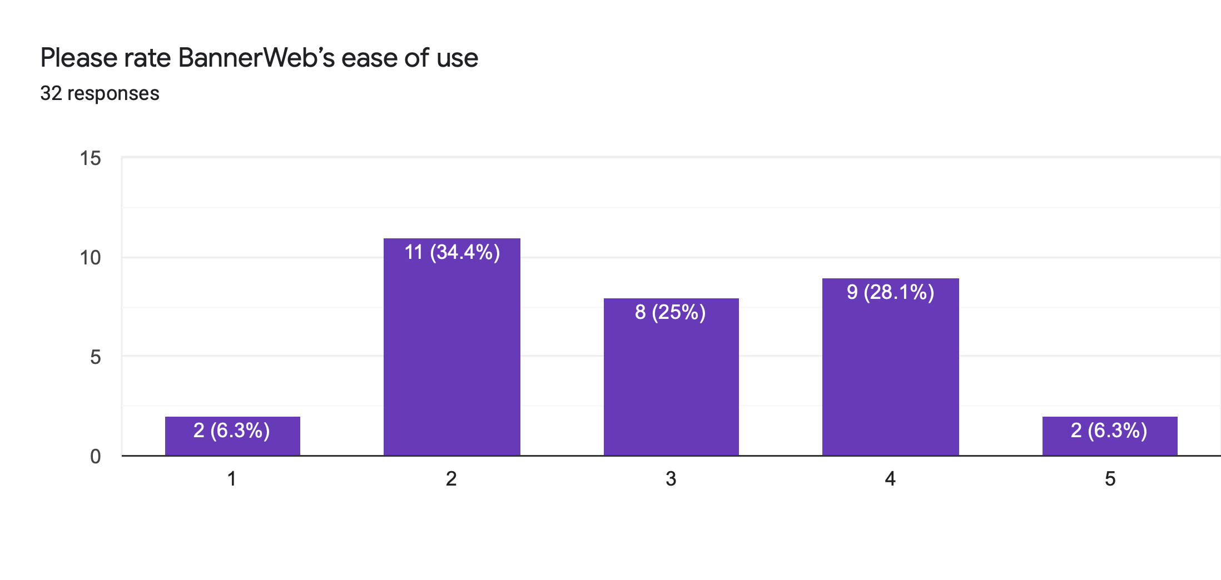
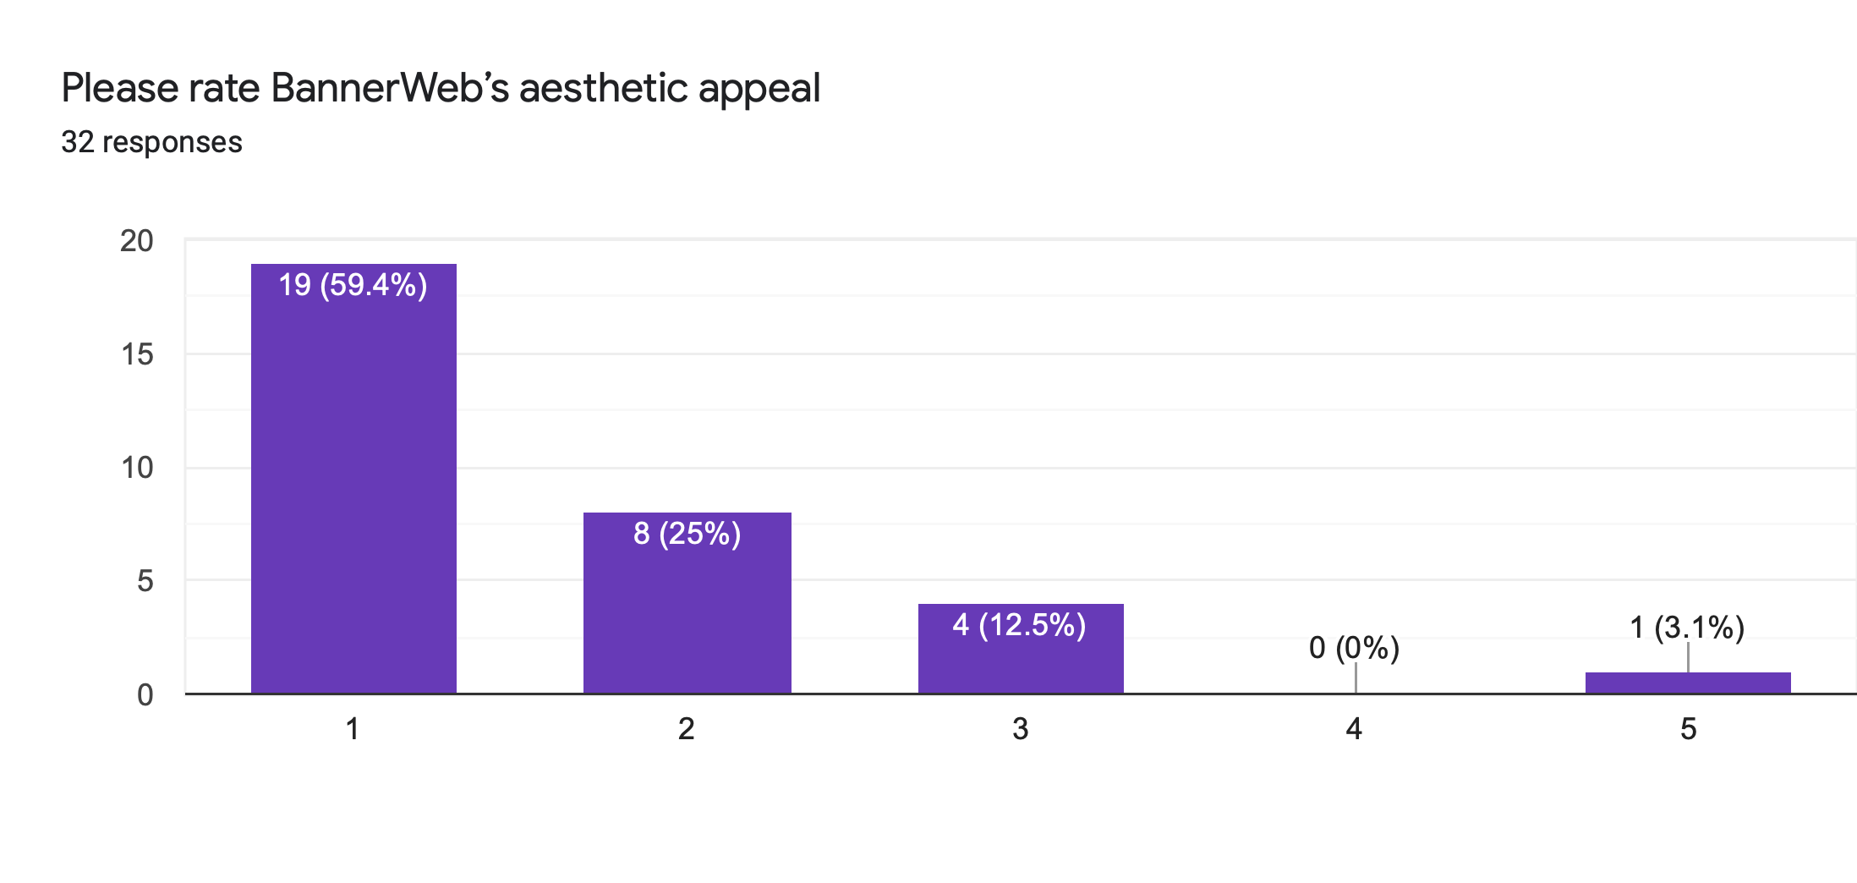
Negative User Experience
Survey
32 WPI Students
Ease of Use
1 - Poor
5 - Exceptional
Number of Students
Rating
Aesthetic Appeal
1 - Poor
5 - Exceptional
Number of Students
Rating
Notes:
Joe
We performed a poll of 32 WPI students and asked them about the usability and aesthetic appeal of the program. Students rated ease of use at 2.93, while they rated aesthetic appeal at 1.63. All of the averages were below 3 suggesting that users do not have a great user experience.

Slide 8


Loss of Opportunities
Reasons
BannerWeb is the first impression for students
Alumni reviews could reflect negative experience with BannerWeb
Future WPI reputation can be impacted
WPI ranking on US News dropped
Notes:
Vandana
Having a poor user experience can lead to a loss of opportunities for WPI. BannerWeb is the first impression for new students and having a negative experiences could lead to a drop in WPI’s rankings, reputation, and possibly financial support.

Slide 9
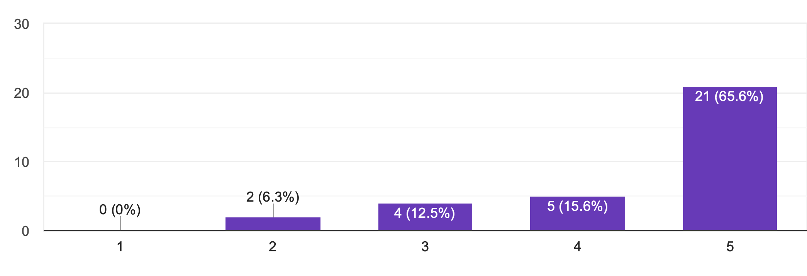
Students want BannerWeb to Improve
Should BannerWeb be improved?
1 - Strongly disagree
5 - Strong agree
Number of Students
Rating
Notes:
Joe
In addition, students want BannerWeb to be improved. In the same poll, more than half of students thought that BannerWeb should be improved. Students are WPI’s customers and most if not all want some meaningful change.

Slide 10


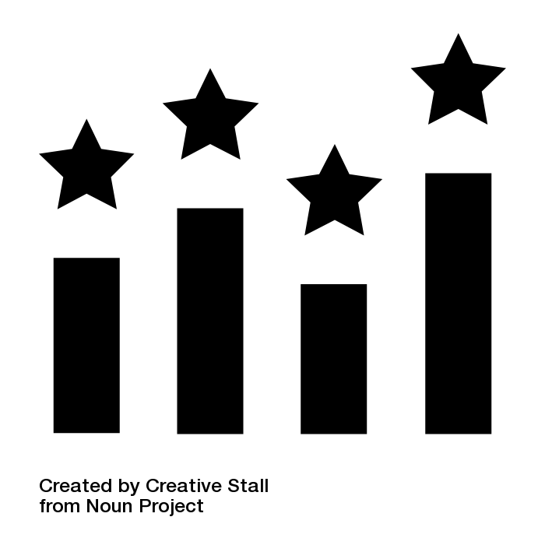
Value from the Project
Positive Reputation
Higher Rankings
Increased Financial Support
Notes:
Vandana
The value we can derive from pursuing a bannerweb redesign is gaining a positive reputation from students which can lead to obtaining higher rankings in college news reports and thus increased financial support from alumni and incoming students.

Slide 11
Methodology

Slide 12
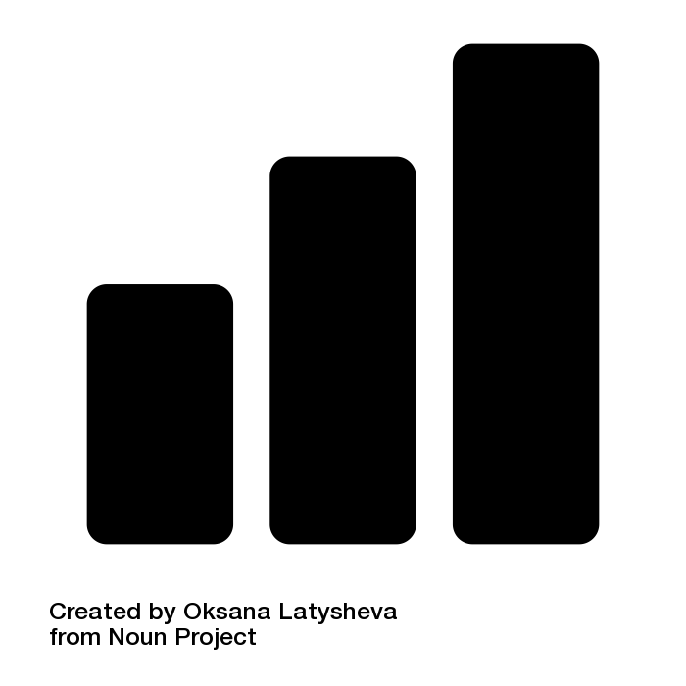



Methodology
Identify
Analyze
Ideation
Design
Notes:
Our methodology is divided into four steps: Identify goals, Analyze, Ideation and Design,

Slide 13

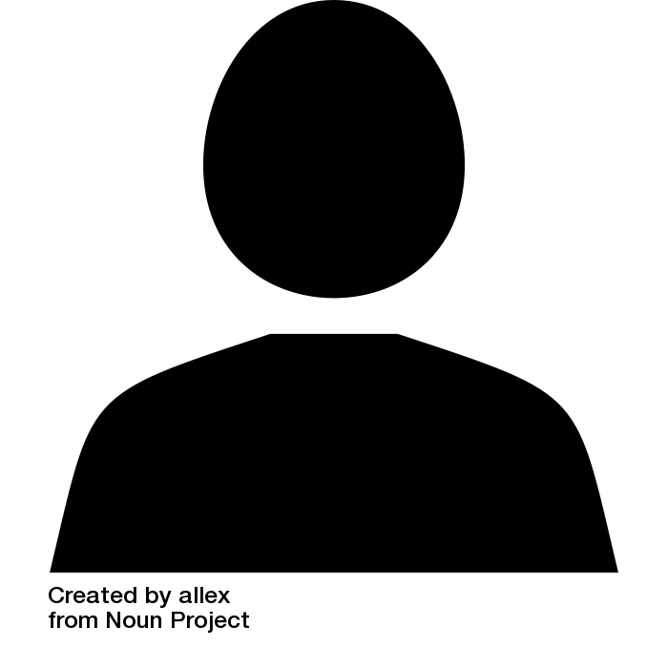
Identify Goals
Business Goals
Improve product quality
Gain exposure
Increase financial support
User Goals
Improve usability
Modernize interface
Notes:
In the first step, we found which goals were meaningful to the business, WPI, and users. We found that the business’s goals were to improve the student experience, gain exposure for the school, and increase financial support for WPI. For users, we found that they want an easy to use application with a modern interface.

Slide 14


Analyze
User Personas
Journey Map
Notes:
In our next step Analysis, we created user personas and journey maps to understand and address student needs and pain points.

Slide 15
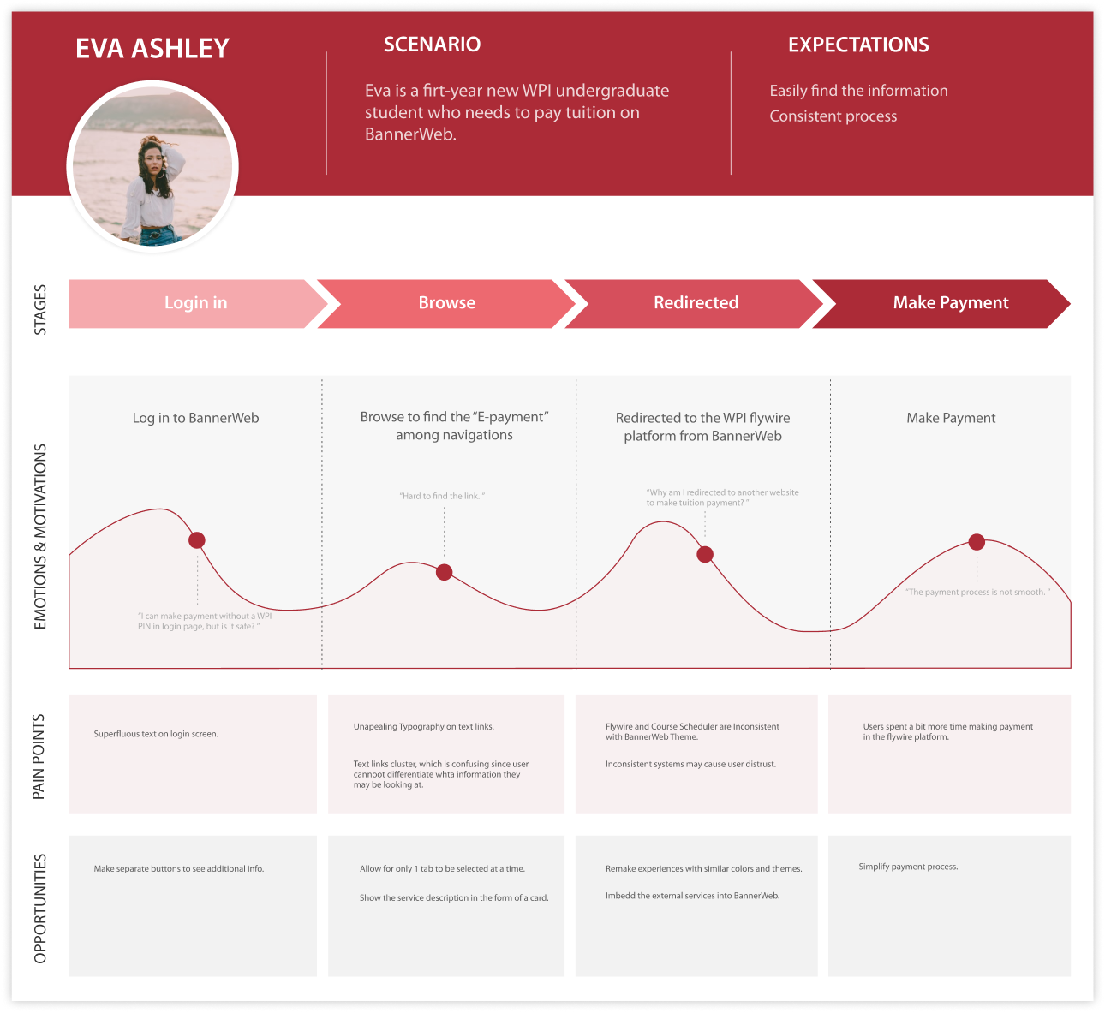
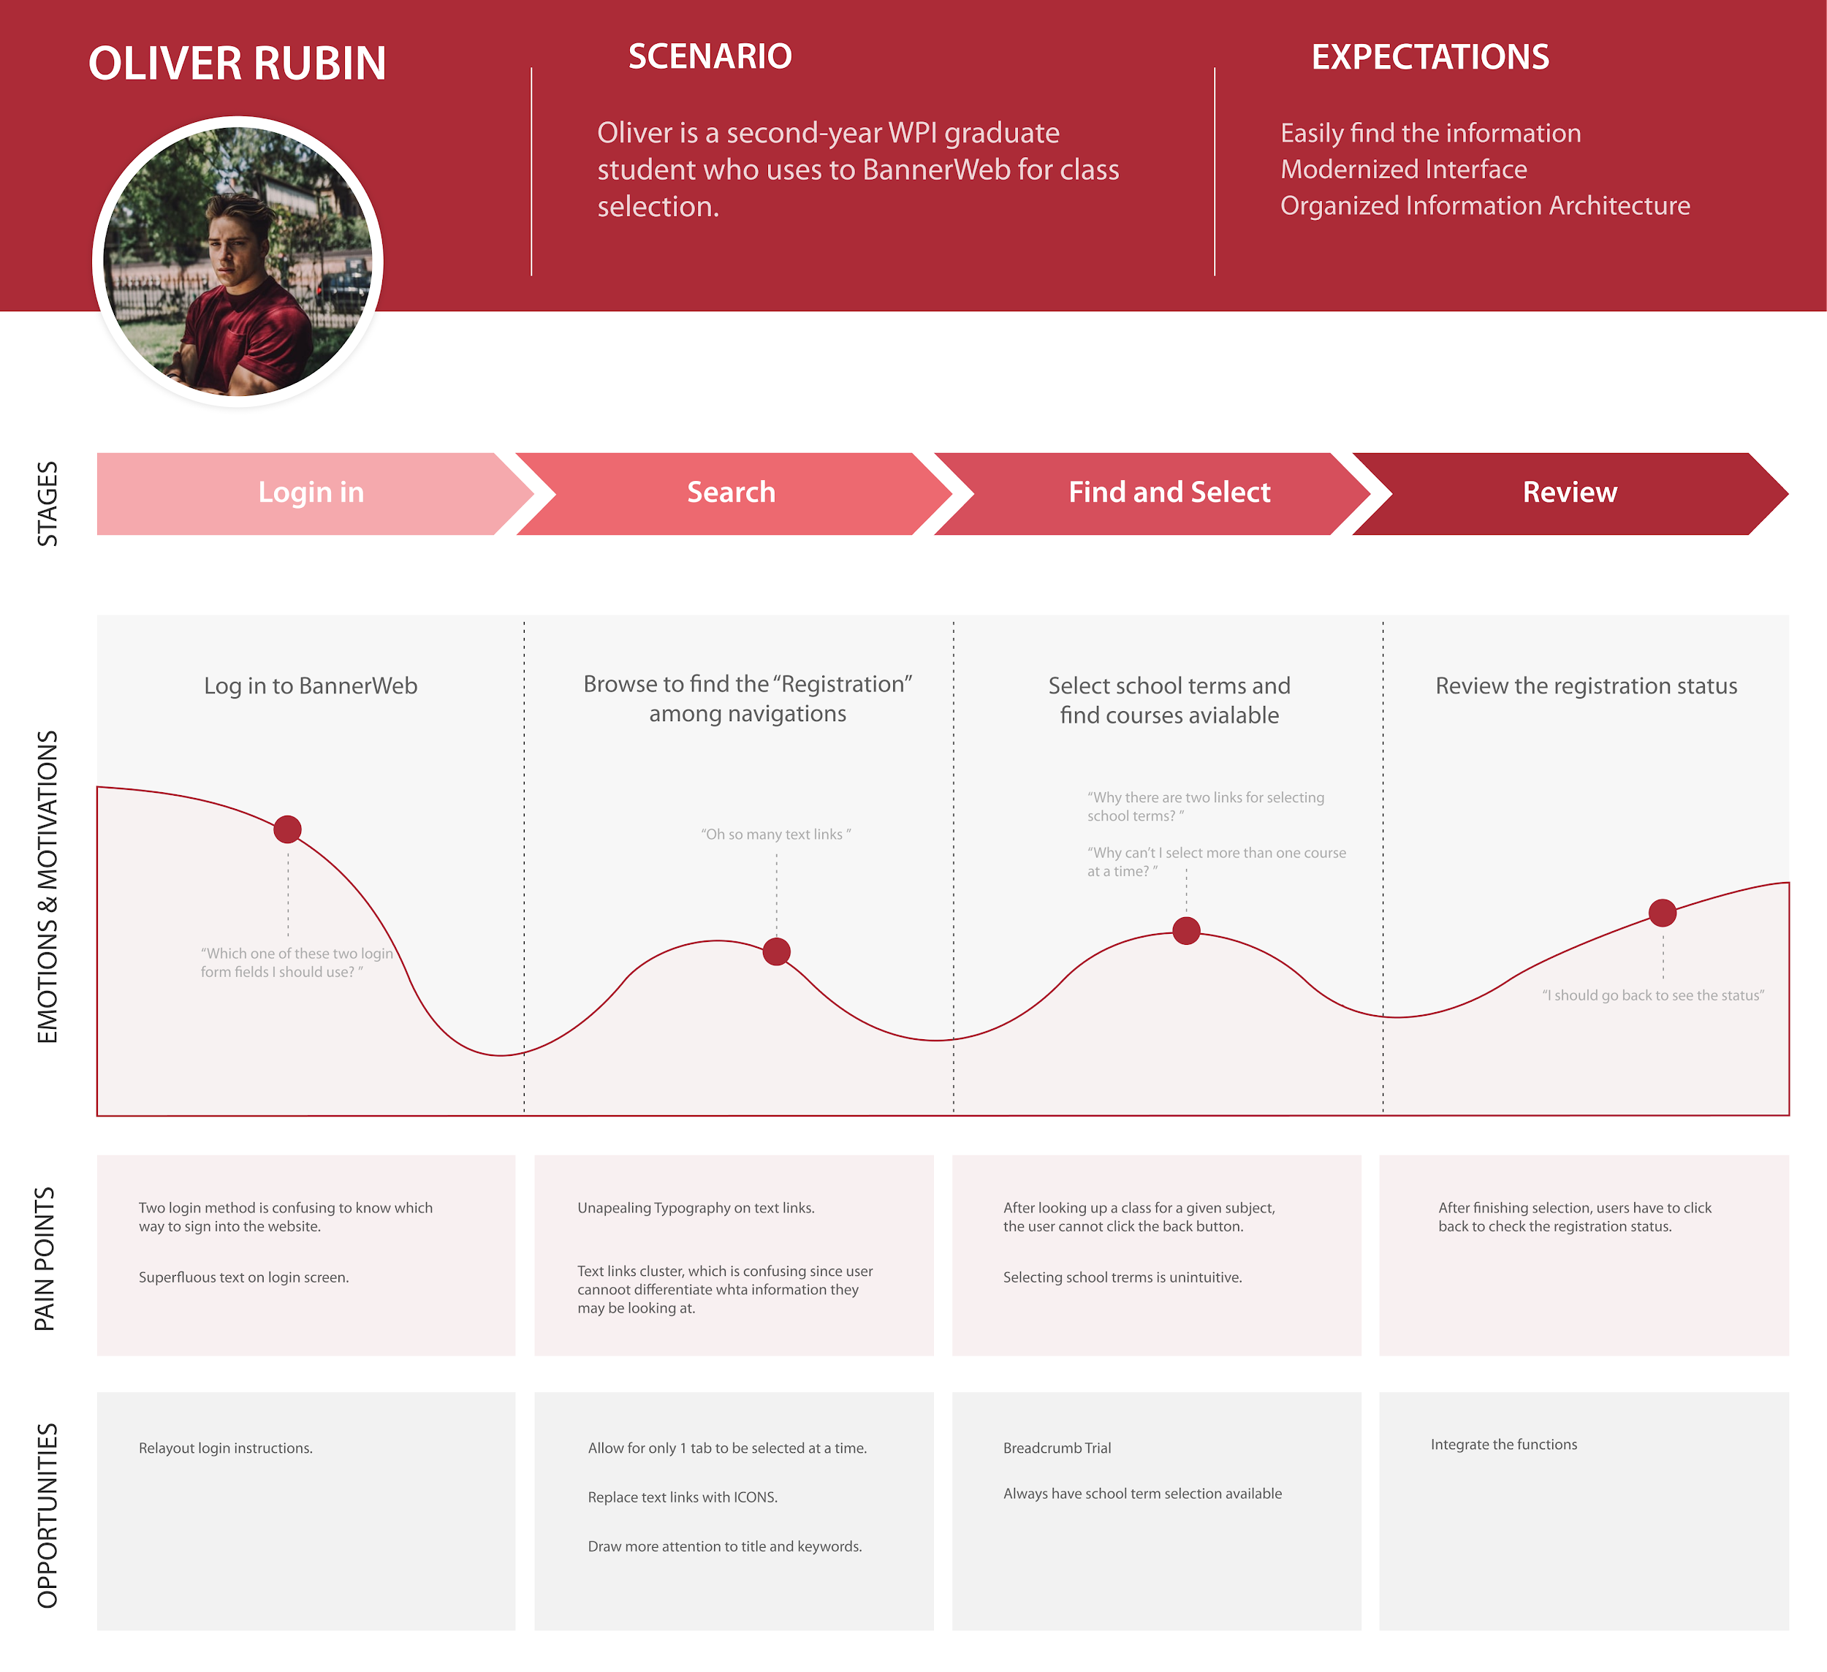
User Personas & Journey Map
Notes:
We created Eva Ashley and Oliver Rubin. Eva is a new WPI undergraduate student who needs to pay tuition on BannerWeb. Oliver Rubin is a second-year WPI graduate student who uses BannerWeb to add-drop classes. Here we map out the user’s pain points with the current program. The issues and solutions we collected from these studies will be explained in following parts.

Slide 16




Ideation
Aesthetic
Navigation
System Feedback
External Applications
Notes:
In the ideation step, we categorized the pain points we found with BannerWeb into 4 problem groups: Aesthetics, Navigation, System Feedback, and External Applications. We discuss them in more depth and talk about our proposed solutions to those problems.

Slide 17


Aesthetic
Problems
Visuals are inconsistent with WPI’s image
Solution
Apply WPI colors and branding to background, assets, and typography
Add photos of WPI campus to show affiliation with WPI
Simplify text descriptions
Current Color Palette
Color Palette for WPI’s theme
Notes:
The first issue was BannerWeb’s aesthetic. The colors and theme of BannerWeb do not match WPI’s professional modern one. To fix this, we can adhere to WPI’s branding guidelines about font and colors as well as add WPI photos and simplify long text descriptions.

Slide 18
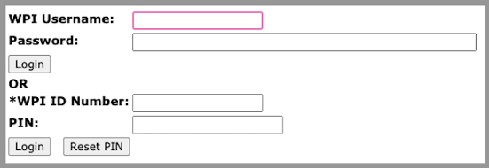
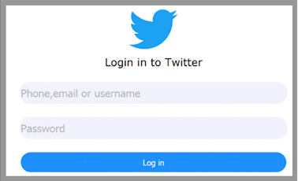
Navigation
Problems
Broken Navbar
Two Login Form Fields
Cluttered Links
Solutions
Card Sorting
Combine the two login methods. Allow users to input a variety of identifiers.
Navigation breadcrumb trail
Notes:
The second issue was navigation. We found that the nav bar and login page were confusing to use and there were many links on pages that felt overwhelming. We used card sorting to split up links more effectively, simplified the login page to have 1 set of login fields, and added a navigation breadcrumb trail so that users can more easily navigate the site.

Slide 19
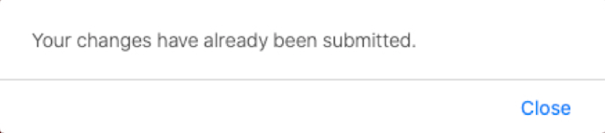
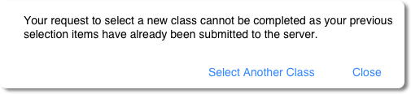
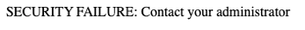
System Feedback
Problems
Unactionable Errors
Unhelpful Error Messages
Solutions
Add actions for users to fix error
Explain reasoning of error
Notes:
The third issue was a lack of system feedback. When looking up classes or going to blocked pages, error messages were not descriptive nor prescribed actionable steps. As a result, these issues could be solved by adding error descriptions and actions that the user could perform to move past the error.

Slide 20
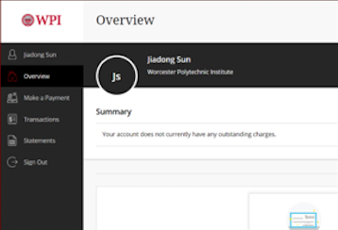

External Applications
Problems
Flywire and Course scheduler do not match with BannerWeb
Solutions
Redo colors and themes of both applications
Ensure user of application affiliation with WPI
Notes:
Lastly, we found that external applications like Flywire and the Coursescheduler could confuse users as they are separate from the BannerWeb application. To make sure users were comfortable with using these external applications, we proposed to either redesign these applications and integrate them into BannerWeb or simply change the styling to match BannerWeb’s theme.

Slide 21
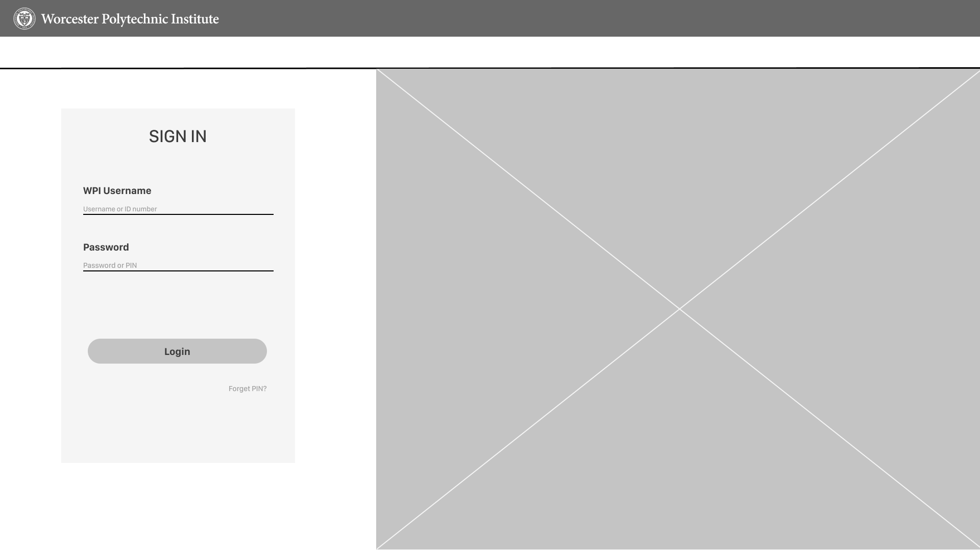
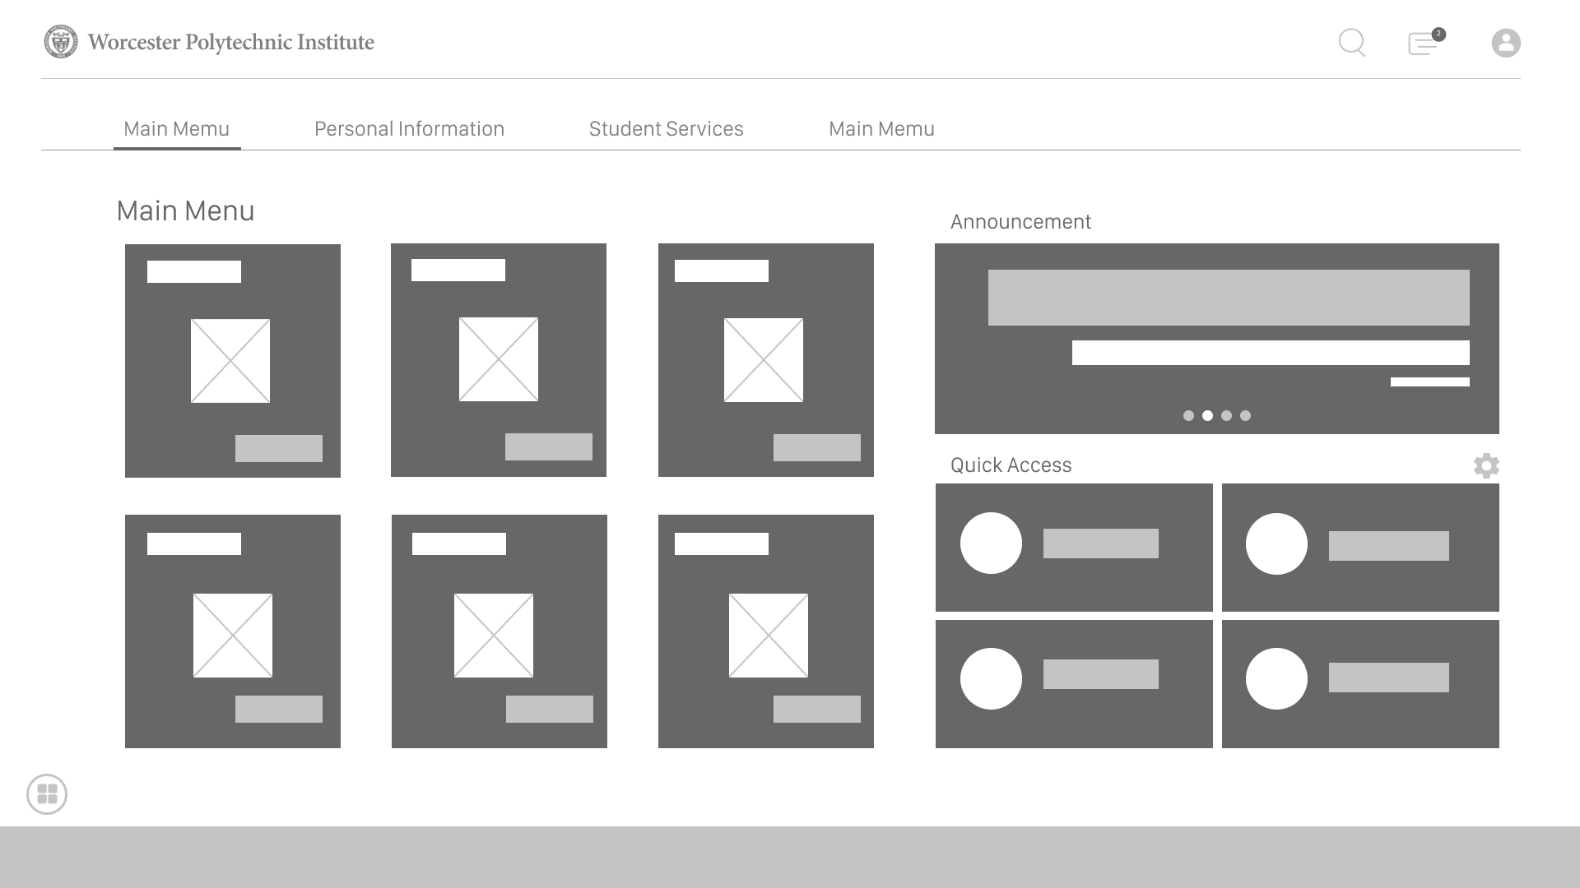
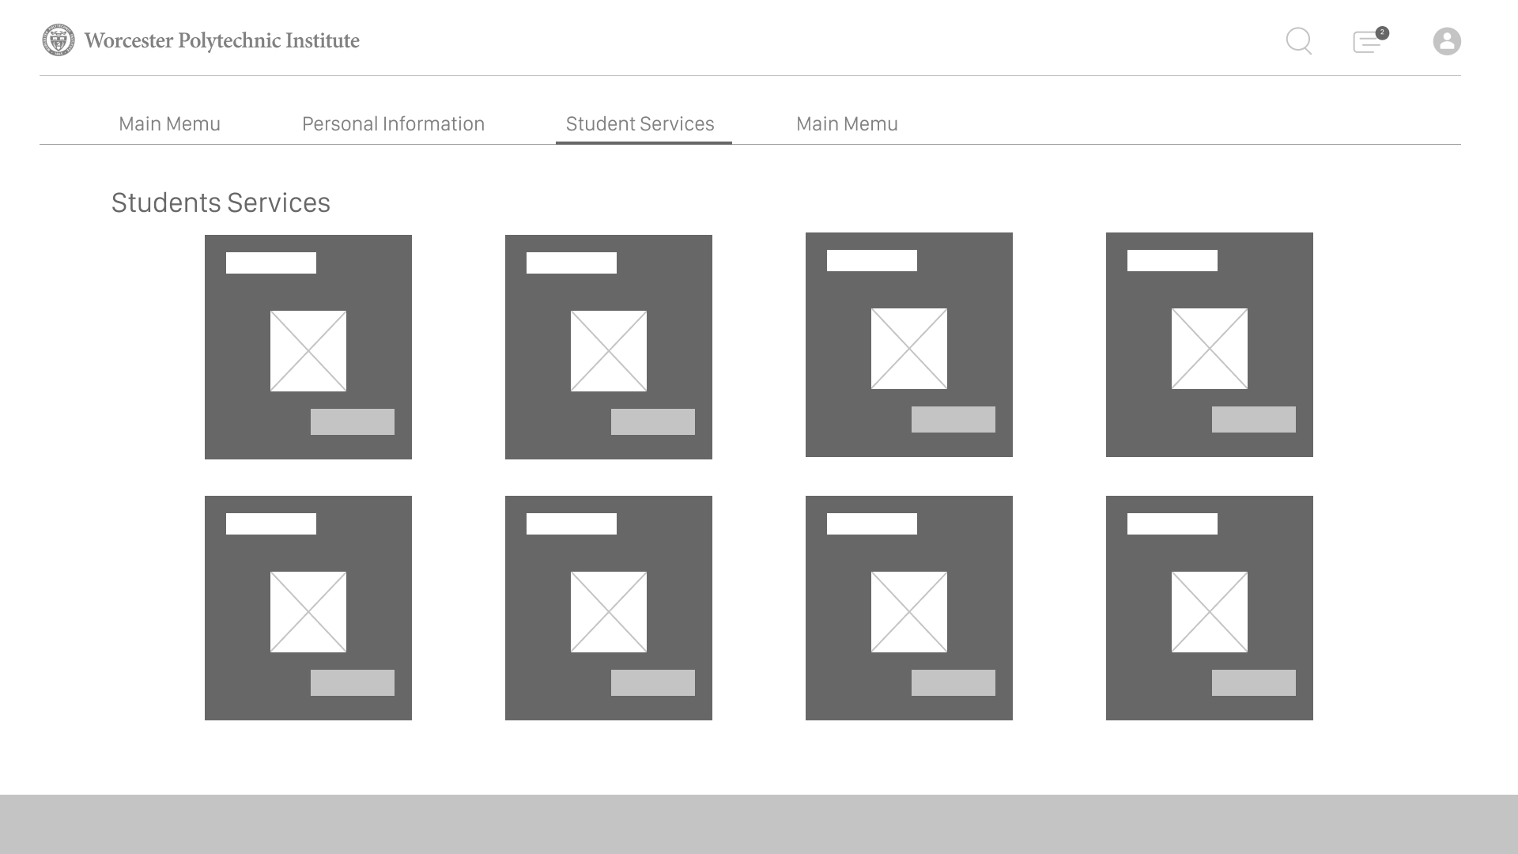
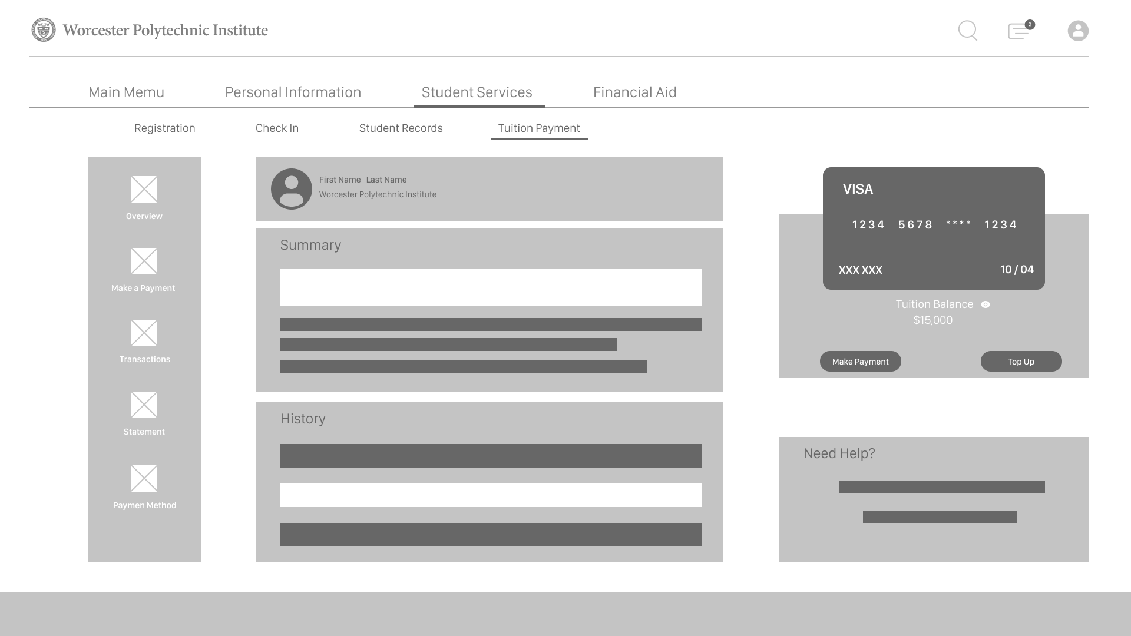
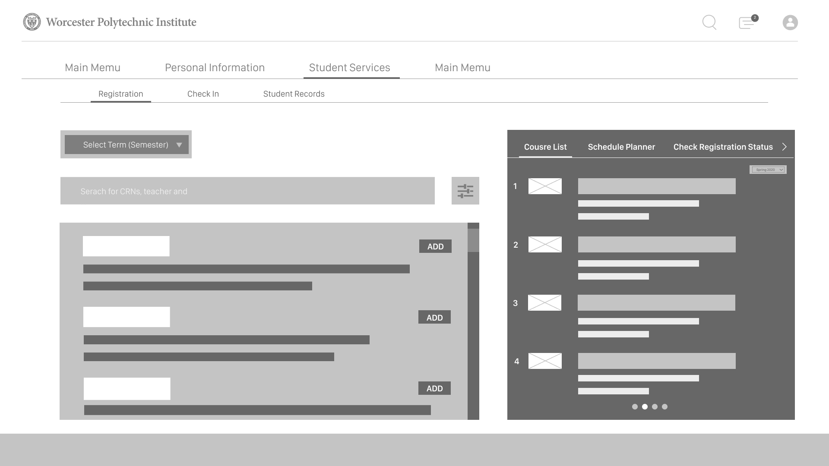
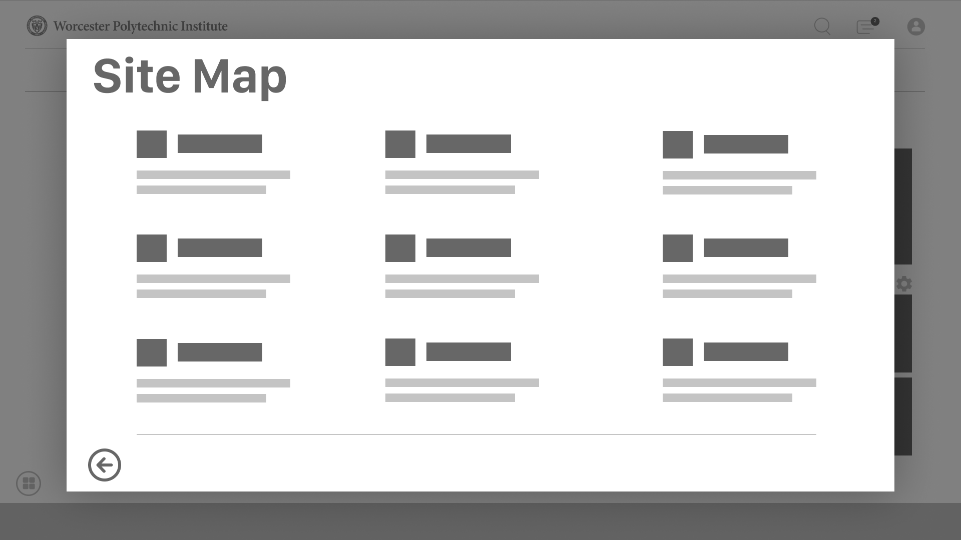
Design
Notes:
According to the solutions that we came up with in the ideation stage, we designed a wireframe as part of the design process to establish the basic structure of the webpage before adding visual aesthetics and content.

Slide 22
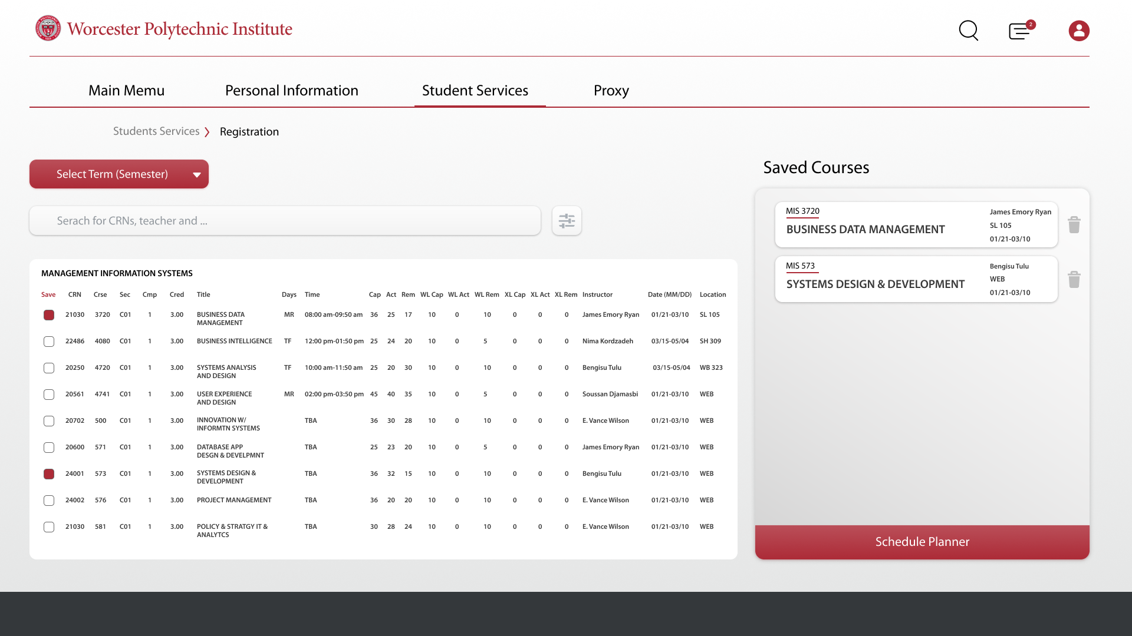
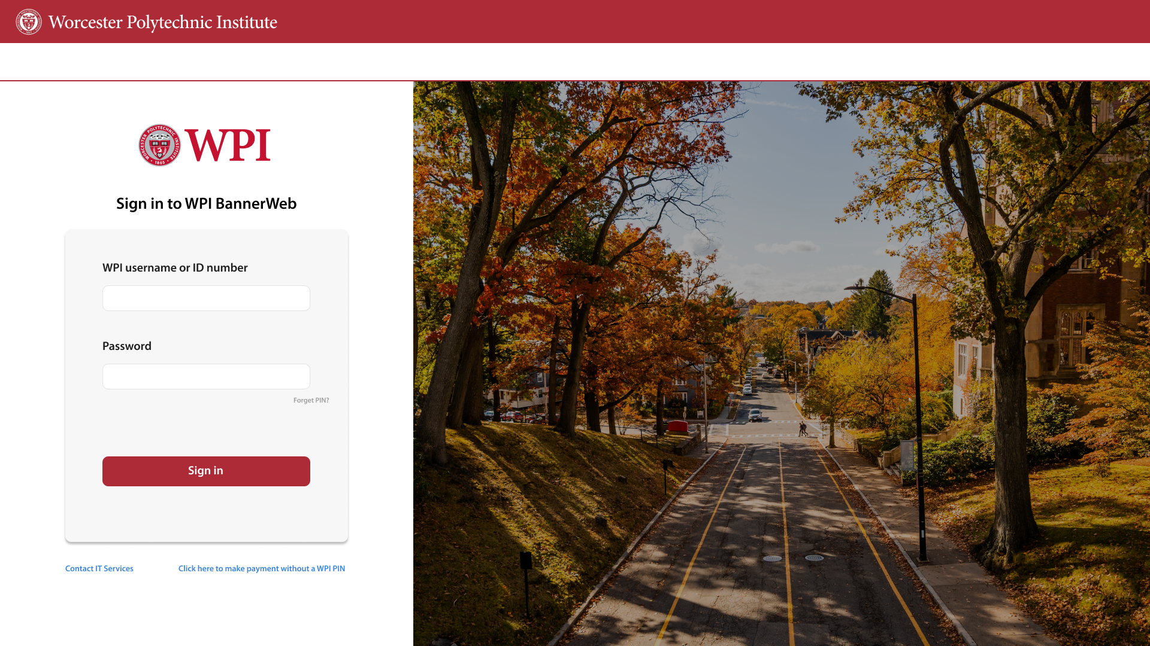
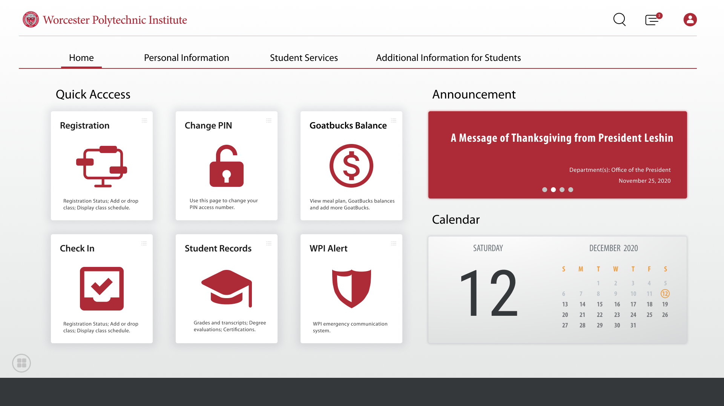
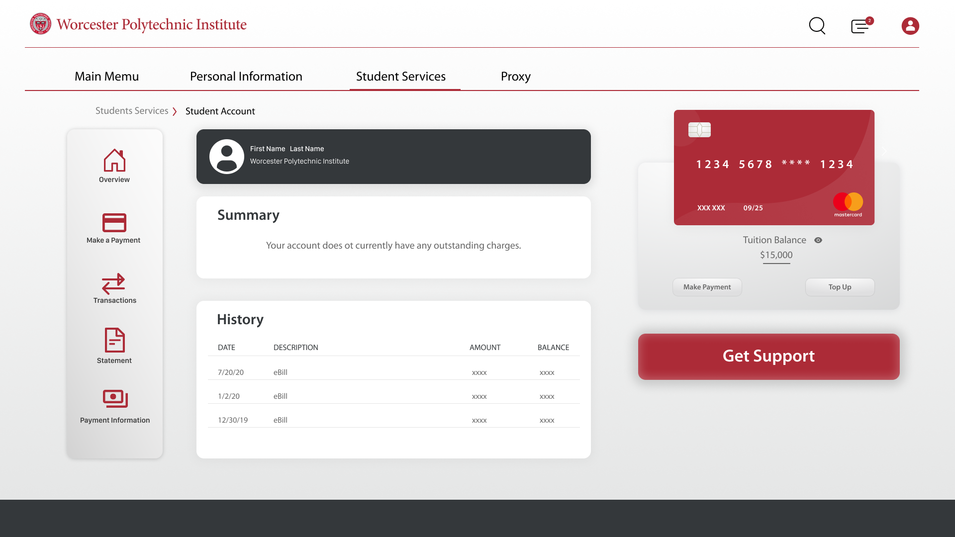
Design
Course Selection
Login
General Page
Tuition Payment
Notes:
After we finished the wireframing, we designed high fidelity mockups to depict the actual content and aesthetics that we plan to showcase. The user flow is shown, starting the user off from the login page, navigating to the general page, and then going to additional pages from there

Slide 23
Design - Login
Notes:
We redesigned the login interface to make it consistent with the style of other WPI login interfaces, like Canvas or the Library database. In addition, by combining the two login methods together, the system will also be able to automatically recognize whether the user enters a student ID or email address.

Slide 24
Design - General Page Layout
Notes:
On the bannerweb homepage, we converted those cluttered text links into interactive cards.

Slide 25
Design - Course Selection
Notes:
We also updated the course scheduler in the student services tab. As you can see, we added a breadcrumb trail to present the user's status or position and functionality to quickly add courses without unhelpful error messages.

Slide 26
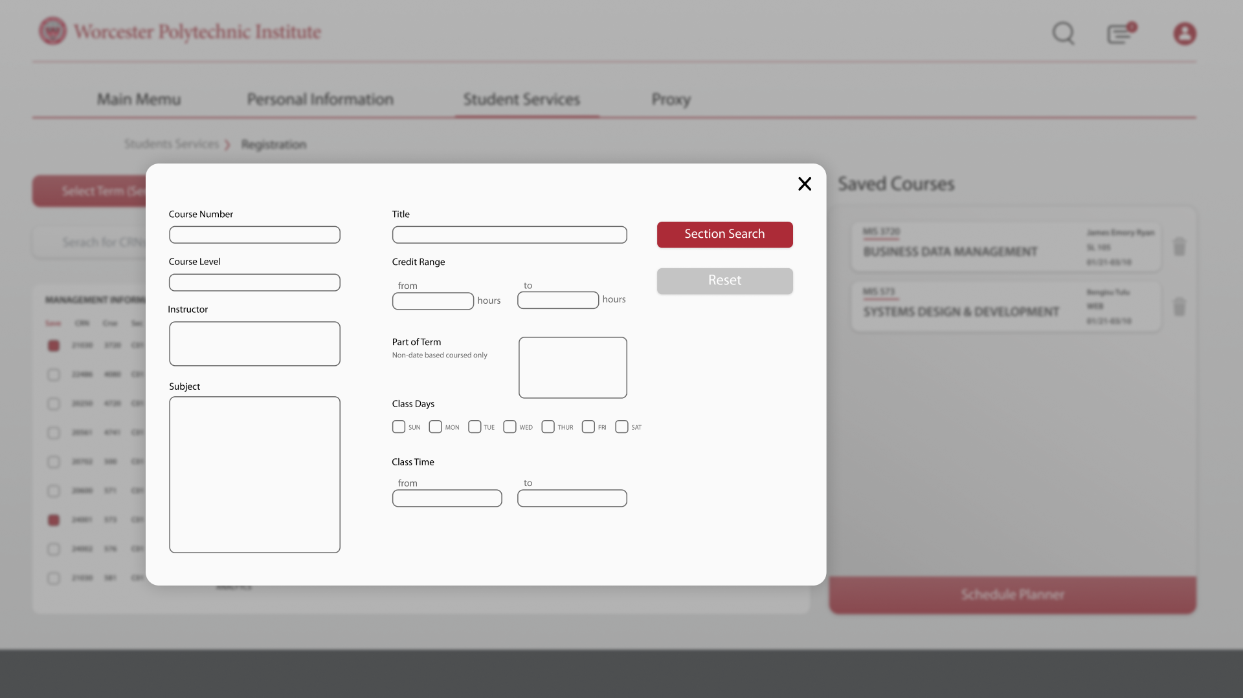
Design - Course Selection: Advanced Search
Notes:
In addition, we have also added a course search function to the student service category. You can see from the slide that you can search for courses based on the information you know.

Slide 27
Design - Payment
Notes:
The last one is a redesign of Flywire inside of the BannerWeb so the user knows they are still in a WPI branded application. In this interface, users can perform financial activities.

Slide 28
Questions?
Feel free to message us in Teams
Notes:
And that is our case study on BannerWeb. Thanks very much for listening and let us know if you have any questions!

